Slide 1

Medicine Side-Effects Analysis
Team 2
Mentors:Vinod, Nitin
Team members: Rasool , Sowmya , Pratap , Medha , Joseph.
25/Feb/2020

Slide 2
Project Architecture / Project Flow
1.start with Business Problem
2. Get and Clean the Data
3. Perform EDA
4. Apply Techniques
5. Insights

Slide 3
Business Problem:
Business Problem:This product could be helpful for companies like 1mg to provide detailed rating of the product over their site. It could also be helpful for the patients who are buying drugs online to check the side effects of the drugs before buying it.
Data Set Details:The Dataset contains patient reviews on specific medicines and with related conditions and their satisfaction rated on a scale of 10(1-Being the worst
and 10- being the excellent)
Objective:The objective of the analysis is to predict that the medicine(drug) when sold, what is the probability that the patient of particular condtion would have side-effects after consuming a particular medicine(drug).

Slide 4
Exploratory Data Analysis (EDA) and
Feature Engineering

Slide 5
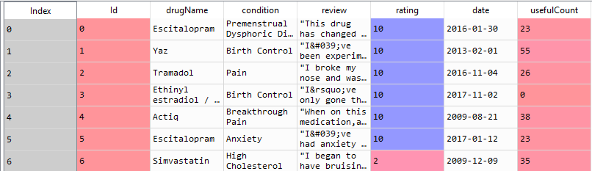
Data set details
40324 entries , 7 Columns
Condition Column has 219 missing values but it can be ignored
Drugname,reviews and ratings are important input data.
Drugname is not unique in the database, for multiple conditions there is similar drug.
Combination of drugname/Condition and review is unique record
Levonorgestrel and Etonogestrel are related to birth control, it has more reviews and ratings
Maximum reviews are for drugname:

Slide 6
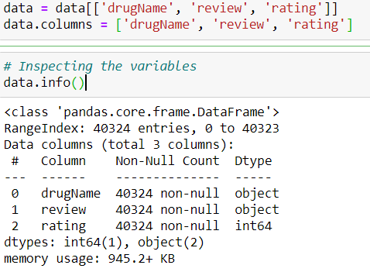
I 3 columns are considered for input

Slide 7
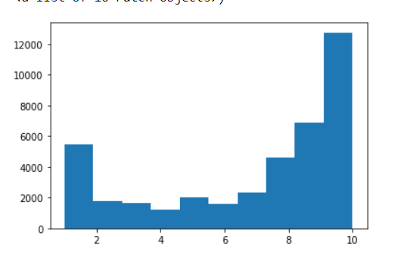

Slide 8
TexttttPText Preprocessing reprocessing
Text Preprocessing
Noise Removal
Lexicon Normalisation

Slide 9
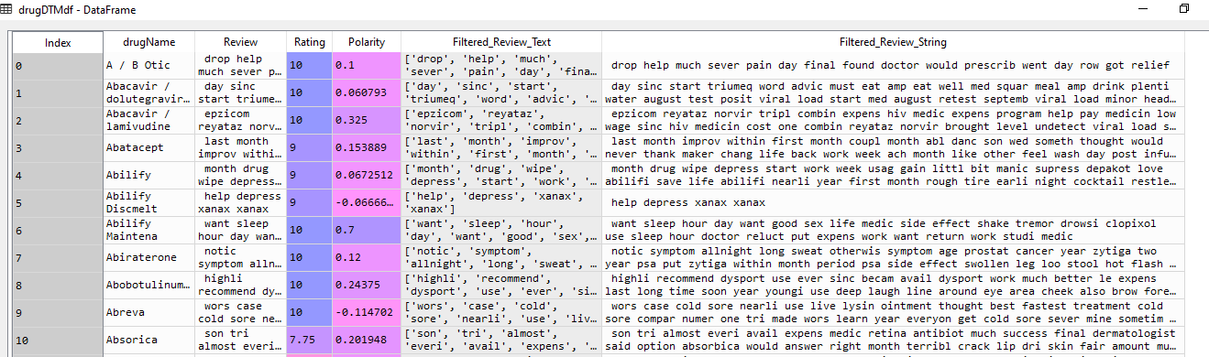

Slide 10
Data Exploration
Merging datasets
Checking out the most salient words
Quick peak at the target variable

Slide 11
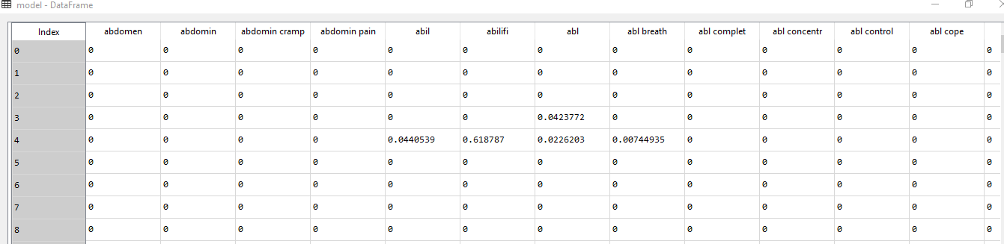

Slide 12
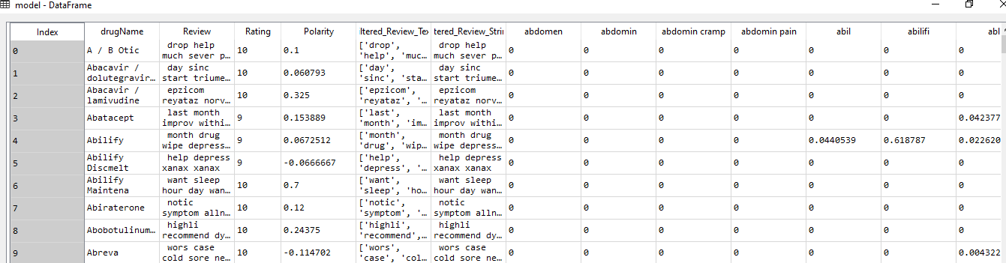
Merged Dataset

Slide 13
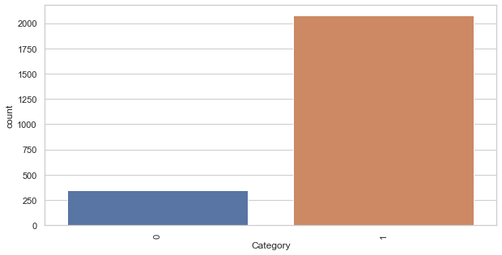
Recommended Rating Plot
model.loc[model['Rating'] > 6, 'Category'] = 1
model.loc[model['Rating'] <= 6, 'Category'] = 0

Slide 14
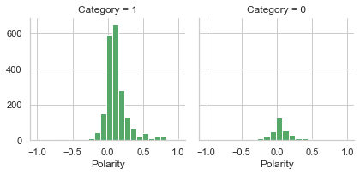
Polarity 0 and 1

Slide 15
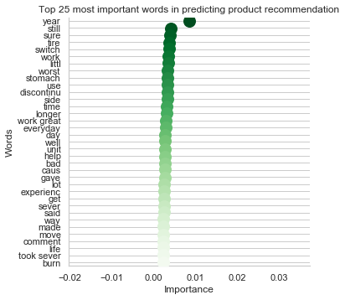

Slide 16
Model Details
Model - Gaussian Naive Bayes
Data set details
Algorithm details and configuration
X = ml_model.drop('Category', axis=1)
y = ml_model['Category']
gnb = GaussianNB()
model(gnb, "Gaussian Naive Bayes", X_train, y_train, X_test, y_test)
Data Partition details
X_train, X_test, y_train, y_test = train_test_split(X, y, test_size = 0.3, random_state=42)
Accuracy: 84%
Class wise accuracies
Recall : 86
Precision : 97
ROC-AUC-Score: 0.9838031316113997

Slide 17
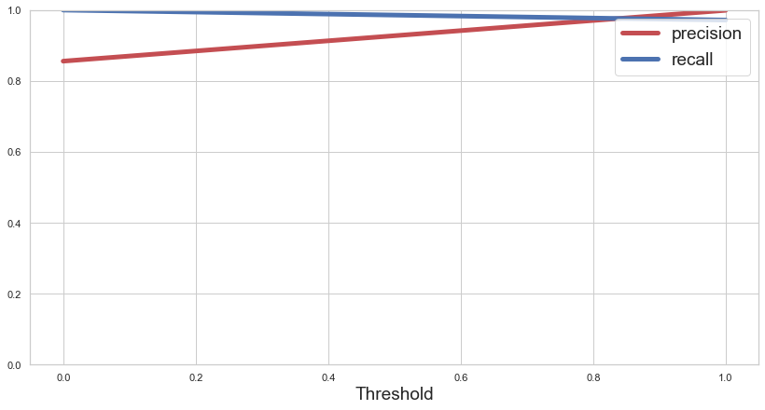
Model - Gaussian Naive Bayes

Slide 18
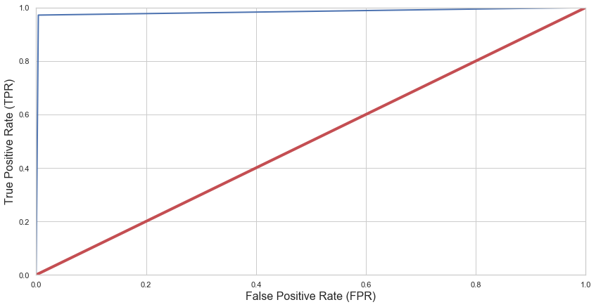
Model - Gaussian Naive Bayes

Slide 19
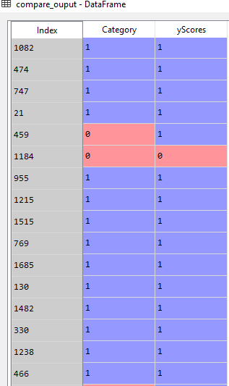
Model - Gaussian Naive Bayes

Slide 20
Model Details
Model - Logistic Regression
Data set details
Algorithm details and configuration
X = ml_model.drop('Category', axis=1)
y = ml_model['Category']
log = LogisticRegression()
model_sm(log, "Logistic Regression", X_train_sm, y_train_sm, X_test_sm, y_test_sm)
Data Partition details
X_train, X_test, y_train, y_test = train_test_split(X, y, test_size = 0.3, random_state=42)
Accuracy: 93%
Class wise accuracies
Recall : 96
Precision : 97
ROC-AUC-Score: 0.9803652038149544

Slide 21
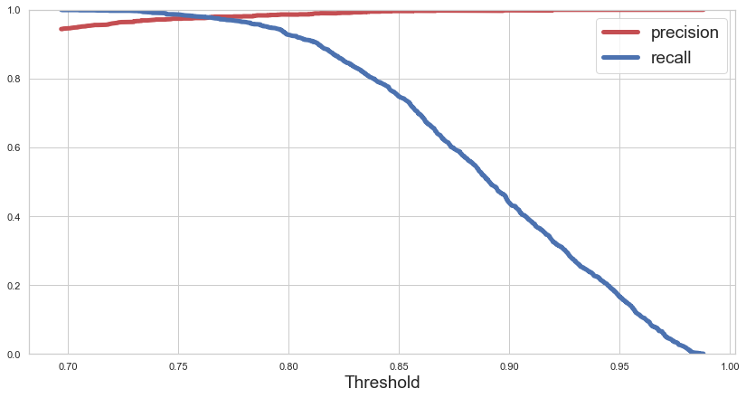
Model - Logistic Regression

Slide 22
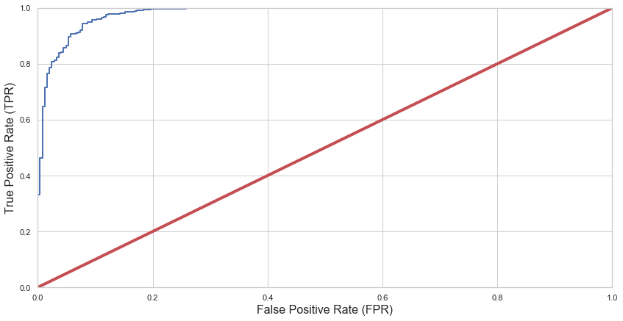
Model - Logistic Regression

Slide 23
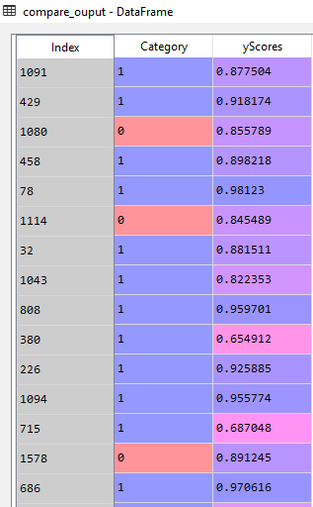
Model - Logistic Regression

Slide 24
Model Deployment using R shiny / Flask or any other method

Slide 25
Challenges faced?
How did you overcome?

Slide 26
Thank you

